Slide 1

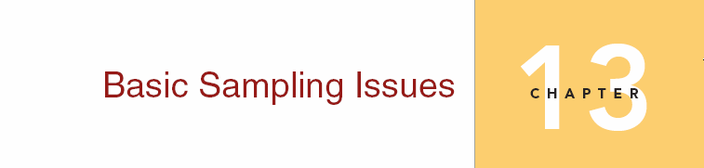
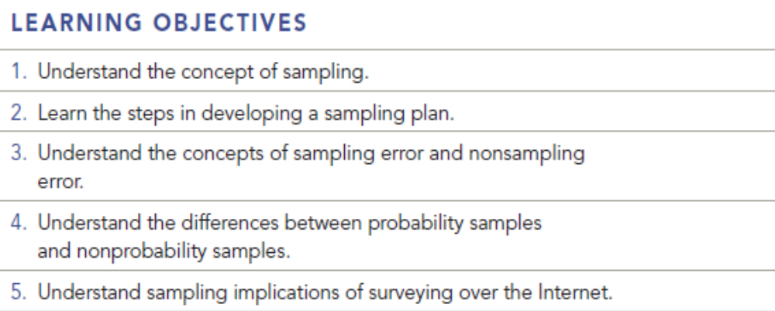

Chapter Thirteen
13-1

Slide 2
Question
What are some situations in which a census would be better than a sample? Why are samples usually taken rather than censuses?

Slide 3
Answer
A census would be better than a sample when a business has only a small group of customers and does not expect to acquire many more. Samples are usually less expensive to administer and are easier to manage. Also, the findings of a sample are often just as statistically accurate as the findings of census would be, leading to the conclusion that you can get equivalent results for less time and money.

Slide 4
Question
Develop a sampling plan for examining undergraduate business students’ attitudes toward Internet advertising.

Slide 5
Answer
Determine the population: All undergraduate students that attend the university.
Determine the sampling frame: A list of all undergraduate students divided by rank or class level obtained from the registrar’s office
Determine data collection method: Telephone survey
Determine sampling method: A quota sample based on gender and class standing
Determine sample size: Depending upon statistical (level of error) requirements, a number will be chosen that is representative of the population of interest.

Slide 6
Answer(cont’d)
Plan for Selecting Sample Elements Since a quota sample has been chosen, a proportional representation of the population of male and females, and freshmen, sophomores, juniors, seniors, and graduate students will be determined. From each subset, an adequate number of students will be chosen.
Execution of Sampling Plan Telephone the chosen students and collect data using a questionnaire.

Slide 7
Question
Given an example of a perfect sample frame. Why is a telephone directory often not an acceptable sample frame?

Slide 8
Answer
A perfect sample frame would be a mailing list or telephone list that perfectly represents the population. For example, if you wished to interview all male individuals aged 25-45 who play golf twice a week, and you were able to obtain a mailing list that contained every individual who fits in that category that would be a perfect sample frame. A telephone book does not contain the names of everyone in a community. It doesn’t even contain the names of everyone that has a telephone. Private listings, unlisted numbers, and cell phone numbers are omitted.

Slide 9
Question
Distinguish between probability and nonprobability samples. What are the advantages and disadvantages of each? Why are nonprobability samples so popular in marketing research?

Slide 10
Answer
A probability sample ensures that each element within the population of interest has a known chance of being chosen. The advantages are: 1) representative cross-section, 2) sampling error can be computed, and 3) survey results are projectable to the total population. The disadvantages are: 1) expensive, 2) more complex design, and 3) it takes more time to execute.
Non probability samples do not ensure that each unit will have a known chance of being chosen. Discretion is usually left up to the researcher. The advantages are: 1) cost less, 2) excellent in exploratory research, 3) execution is quick, and 4) it can be adequately representative. The disadvantages are 1) the sampling error cannot be computed, 2) it may not be representative, and 3) results cannot be projected to the total population. Nonprobability samples are popular because they can be quicker, cheaper, and easier to conduct. Sometimes nonprobability samples give quick answers that are “good enough.”

Slide 11
Question
American National Bank has 1,000 customers. The manager wishes to draw a sample of 100 customers. How would this be done using systematic sampling? What impact would it have on the technique, if any, if the list were ordered by average size of deposit?

Slide 12
Answer
Using systematic sampling, a skip interval of 10 would be determined (1000/100). Every tenth person would be chosen from the list to be included in the sample. If the distribution of the banks depositors is skewed toward the wealthy or toward the very poor depositors, it would have an effect. However, since this would be representative of his customers, it might not be a problem.
Another technique that would yield a more randomly selected sample would be to select every customer whose Social Security number ended in 7, or 4, or whatever. That would be a 10% sample. The last digit of a Social Security number is a random number.

Slide 13
Question
Do you see any problem with drawing a systematic sample from a telephone book, assuming that the telephone book is an acceptable sample from for the study in question?

Slide 14
Answer
If the book is an acceptable sample frame, then the sample would be representative. This might be the case if you are looking for populations of people who are listed in the phone book, have not moved within the last year, and no one has died.

Slide 15
Question
Describe snowball sampling. Given an example of a situation in which you might use this type of sample. Give an example of a situation in which you might use this type of sample. What are the dangers associated with this type of sample?

Slide 16
Answer
Snowball sampling procedures ask respondents to recommend other individuals who share the characteristic of interest. If you are looking for individuals who have been a victim of a particular crime, and you know there is a victim support network in the area, you might use this technique. There may be no other way to obtain the respondent’s names. The danger associated with this type of sample is, of course, the bias that may occur because of the method. The sample may not be a good cross section, also respondents may be reluctant to give referrals.

Slide 17
Question
Identify the following sample designs:
a. The names of 200 patrons of a casino are drawn from a list of visitors for the last month and a questionnaire is administered to them.
b. A radio talk show host invites listeners to call in and vote yes or no on whether handguns should be banned.
c. A dog food manufacturer wants to test a new dog food. It decides to select 100 dog owners who feed their dog’s canned food, 100 who feed their dog’s dry food, and 100 who feed their dog’s semi moist food.
d. A poll surveys men who play golf to predict the outcome of a presidential election.

Slide 18
Answer
Simple random sample
Convenience sample
Quota Sample
A faulty sample. Male golfers are not necessarily representative of the population of interest, registered voters.

Slide 19
Question
Under the right circumstances and all other things equal, _________ produces the most efficient samples and provides the most precise or reliable estimates for a given sample size.
a. Proportional stratified allocation
b. Disproportional stratified allocation
c. Optimal allocation
d. Disproportional Quota allocation
e. None of these

Slide 20
Answer
Ans: B

Slide 21
Question
A researcher invokes a pilot sample and finds that respondents from households with less than $50,000 annual income respond very differently than respondents from households with greater than $50,000 annual income, with regard to the key survey questions. In addition, the researcher’s preliminary results show greater variance among respondents in the over $50,000 households. Given the preceding, which probability sampling method should the researcher invoke and why?

Slide 22
Answer
When a key demographic factor is related directly to the key survey questions and objectives, and there is great variance among respondents across the demographic factors, a stratified random sample should be used. This is because stratified random samples are more statistically efficient than other types of probability sampling techniques; hence, sampling costs, which are usually linear, can be reduced.

Slide 23
Question
Suppose a marketing researcher was doing a survey of snow skiers residing in South Louisiana, for the specific purpose of estimating the feasibility of offering discounted snow ski rental equipment. The idea was gauge the need, interest and price expectations of these snow skiers as they head to Colorado or some other snow skiing destination. What type of sample would be needed?

Slide 24
Answer
It is plausible to assume that there will a low incidence of snow skiers in South Louisiana. Instead of surveying at random, the researcher should resort to a referral or snowball sampling technique.

